Slide 1

Quick Tweet An easier way to tweet
App developed by:
Rong Mu
Kestas Subacius
Kunal S Shah
Rong Chen

Slide 2
Overview
Quick Tweet is a Twitter shortcut that allows the user to send a tweet straight from the app without being distracted by varies information displayed in Twitter client. This app utilizes Twitter APIs and allows such functions as login, tweet and switch account. The app window would automatically close after a tweet is successfully sent so that the user can switch to other apps quicker. The design of this app focuses on efficiency and the interface thus is minimized in order to provide a clearer view of the tweeting UI.

Slide 3
The “invisible” login-check activity
Whenever the app is reopened after being closed, the app would first check whether the user is currently logged in. If so, this activity would start the window of sending a tweet. Otherwise, the user would be prompted to log in using his/her twitter account information. This activity has no layout because it does not require one. All the checking is done without user’s knowledge, making the whole app faster and lighter.

Slide 4
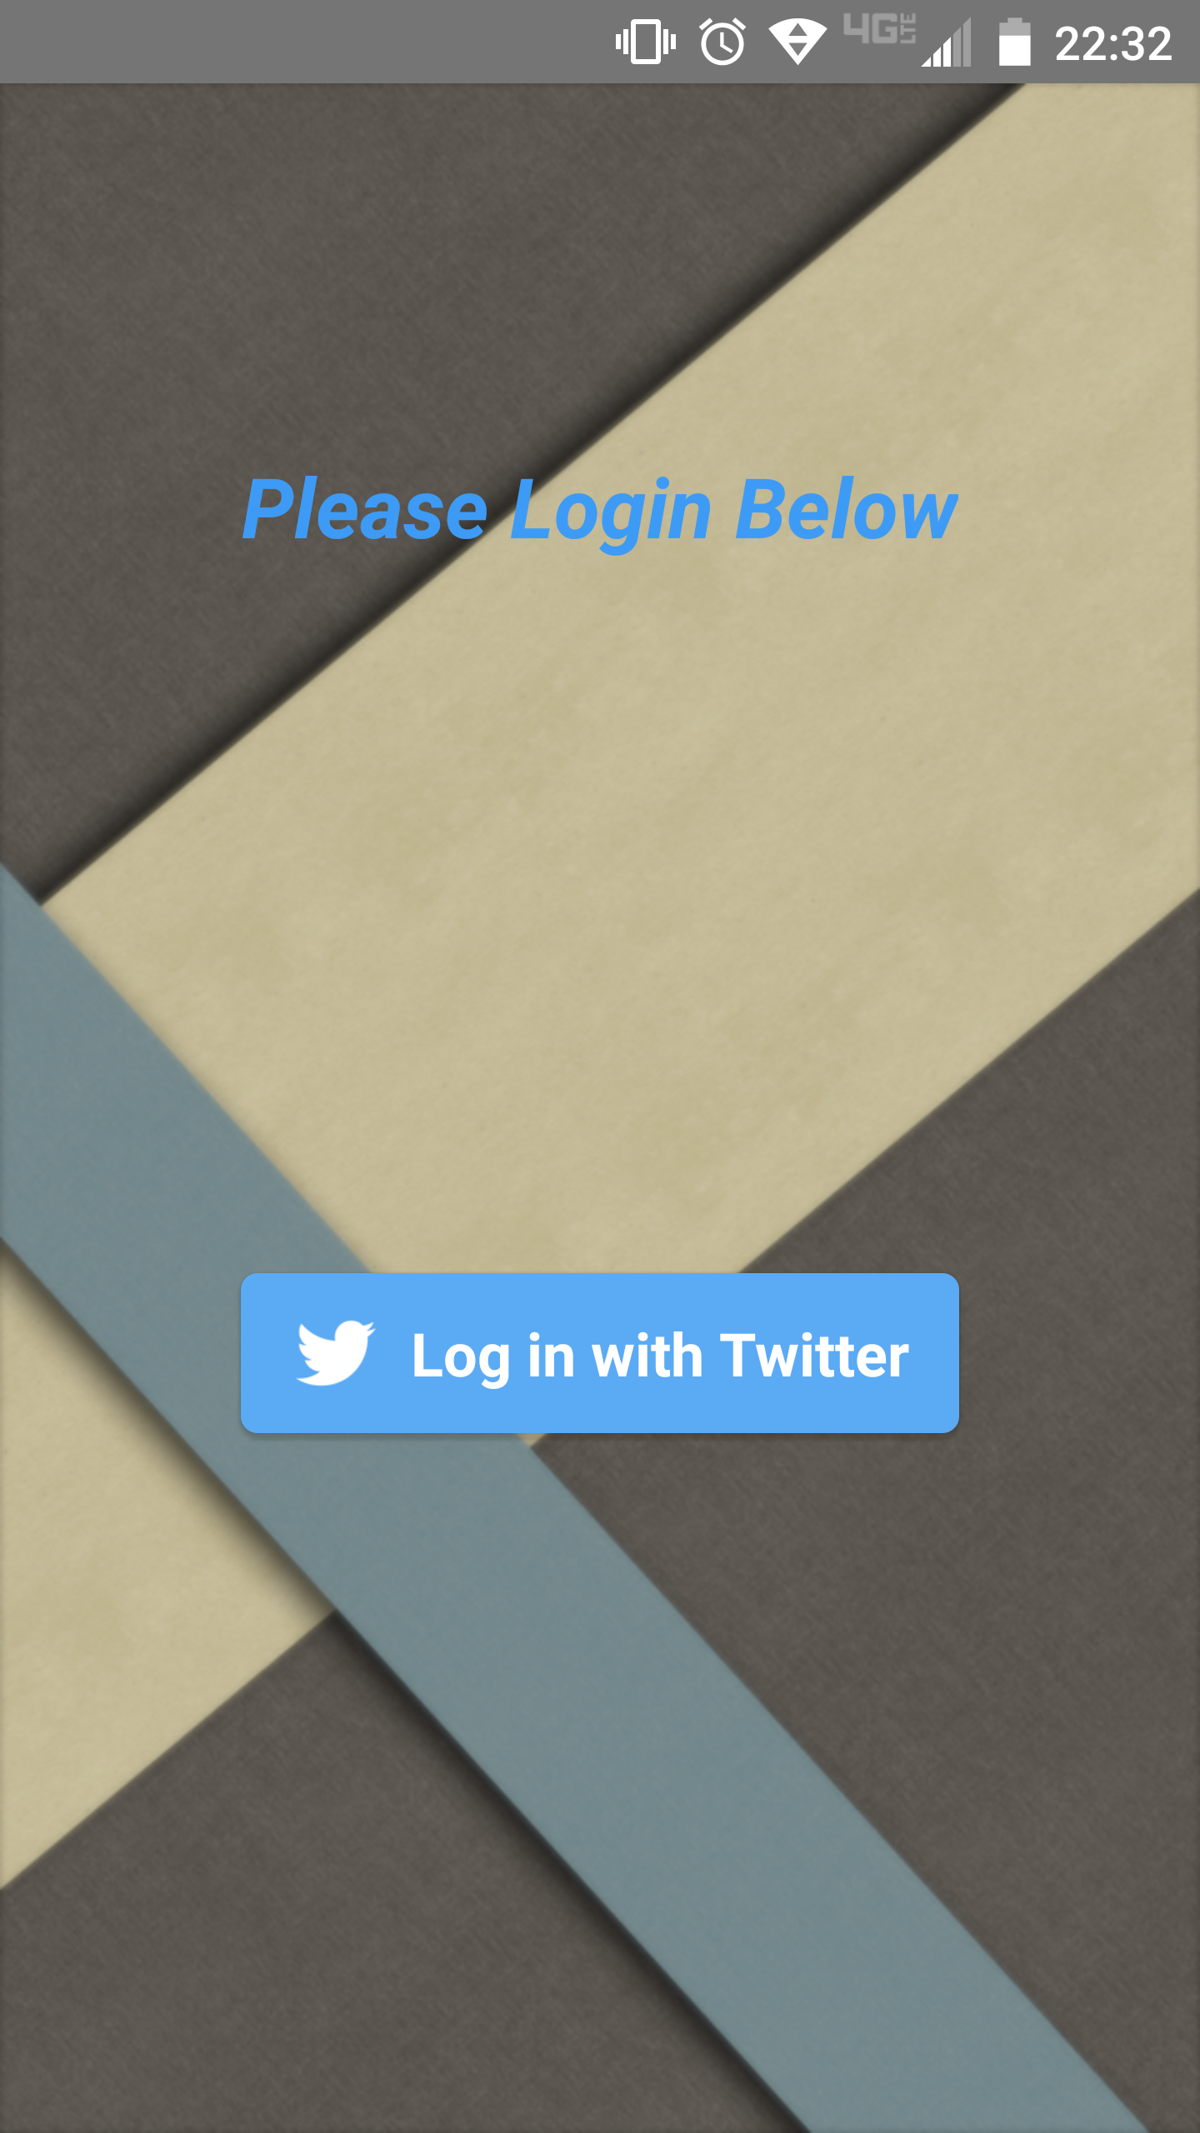
The Login Screen
This screen prompts the user to log in. By taping on the “Log in with Twitter” button, the user would be directed to Twitter’s website to log in using Twitter username and password. If the user already has the official Twitter client installed, an authorization page like the one on the next slide would show up instead.

Slide 5
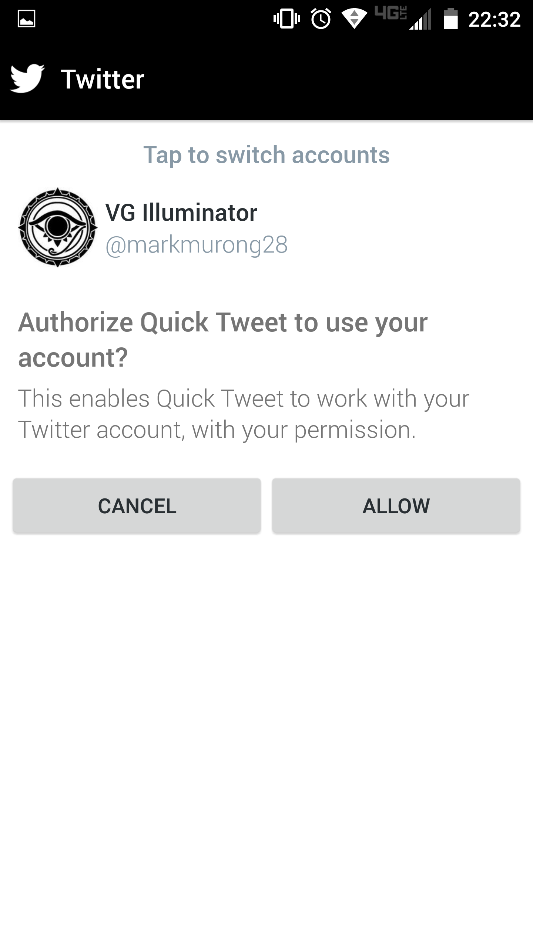
The login/authorization page
This screen allows the user to sign in his/her Twitter account and authorize Quick Tweet to use that account to send tweet. All the data about username and password is transmitted through Twitter Client or browser. Privacy is thus protected.

Slide 6
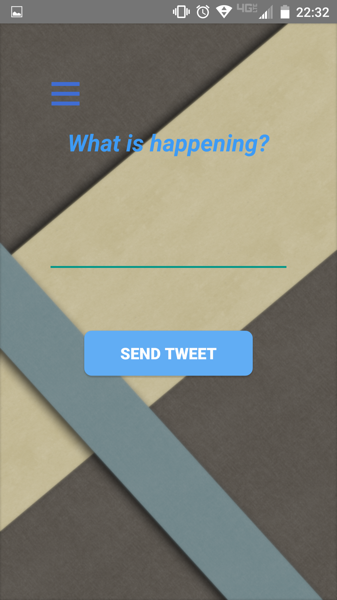
The Send-Tweet Screen
This screen is the core of the app. It allows the user to input the desired Tweet content in the textbox. Then, by hitting the “SEND TWEET” button, the text input would be sent through Twitter API to the server and be displayed on the user’s timeline. A system message “Sent Successfully” would be displayed on the screen to inform the user. This screen would then be closed after a tweet is successfully sent, allowing the user to switch to other apps more efficiently.

Slide 7
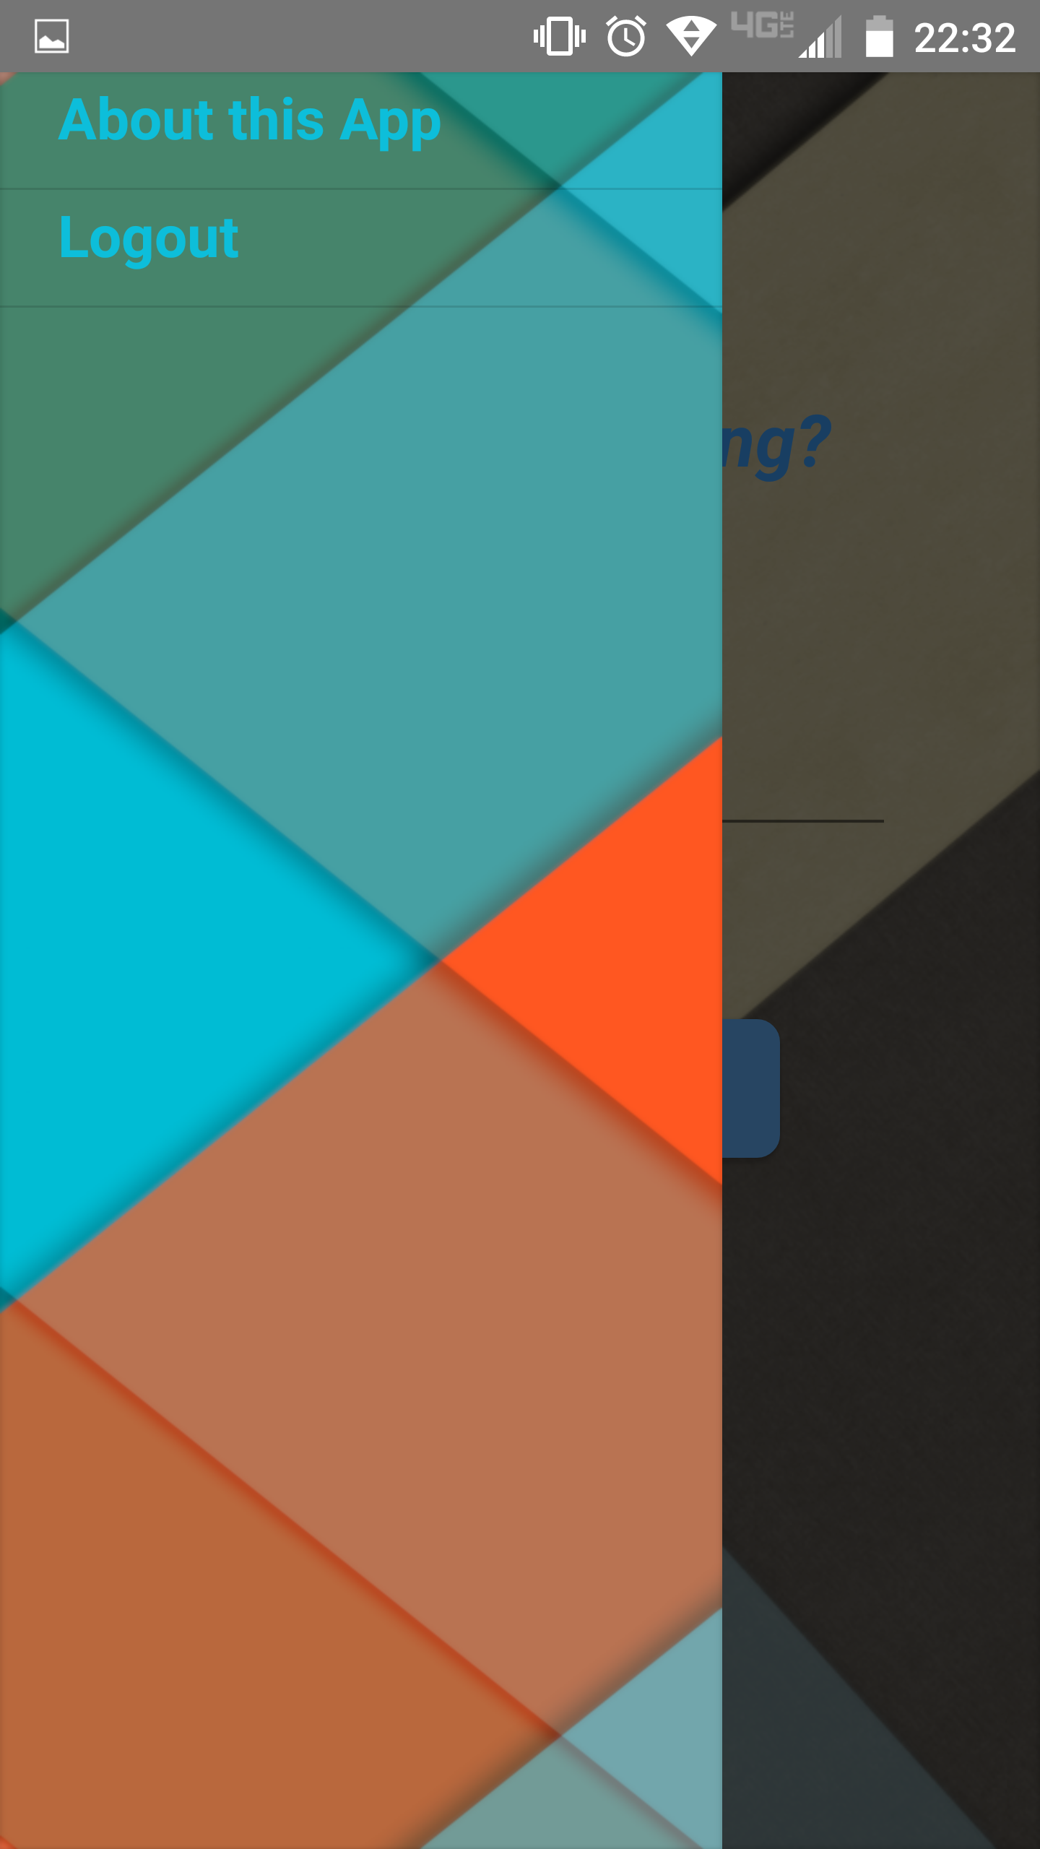
The Drawer Menu
The Drawer menu is part of the Sent-Tweet layout. It includes other functions of the app besides sending a tweet, including Logout and App Information. The user would be taken to the Login screen if the “Logout” option is hit. In addition, an information page (on the next slide) about this app would show up if the “About this App” option is taped.

Slide 8
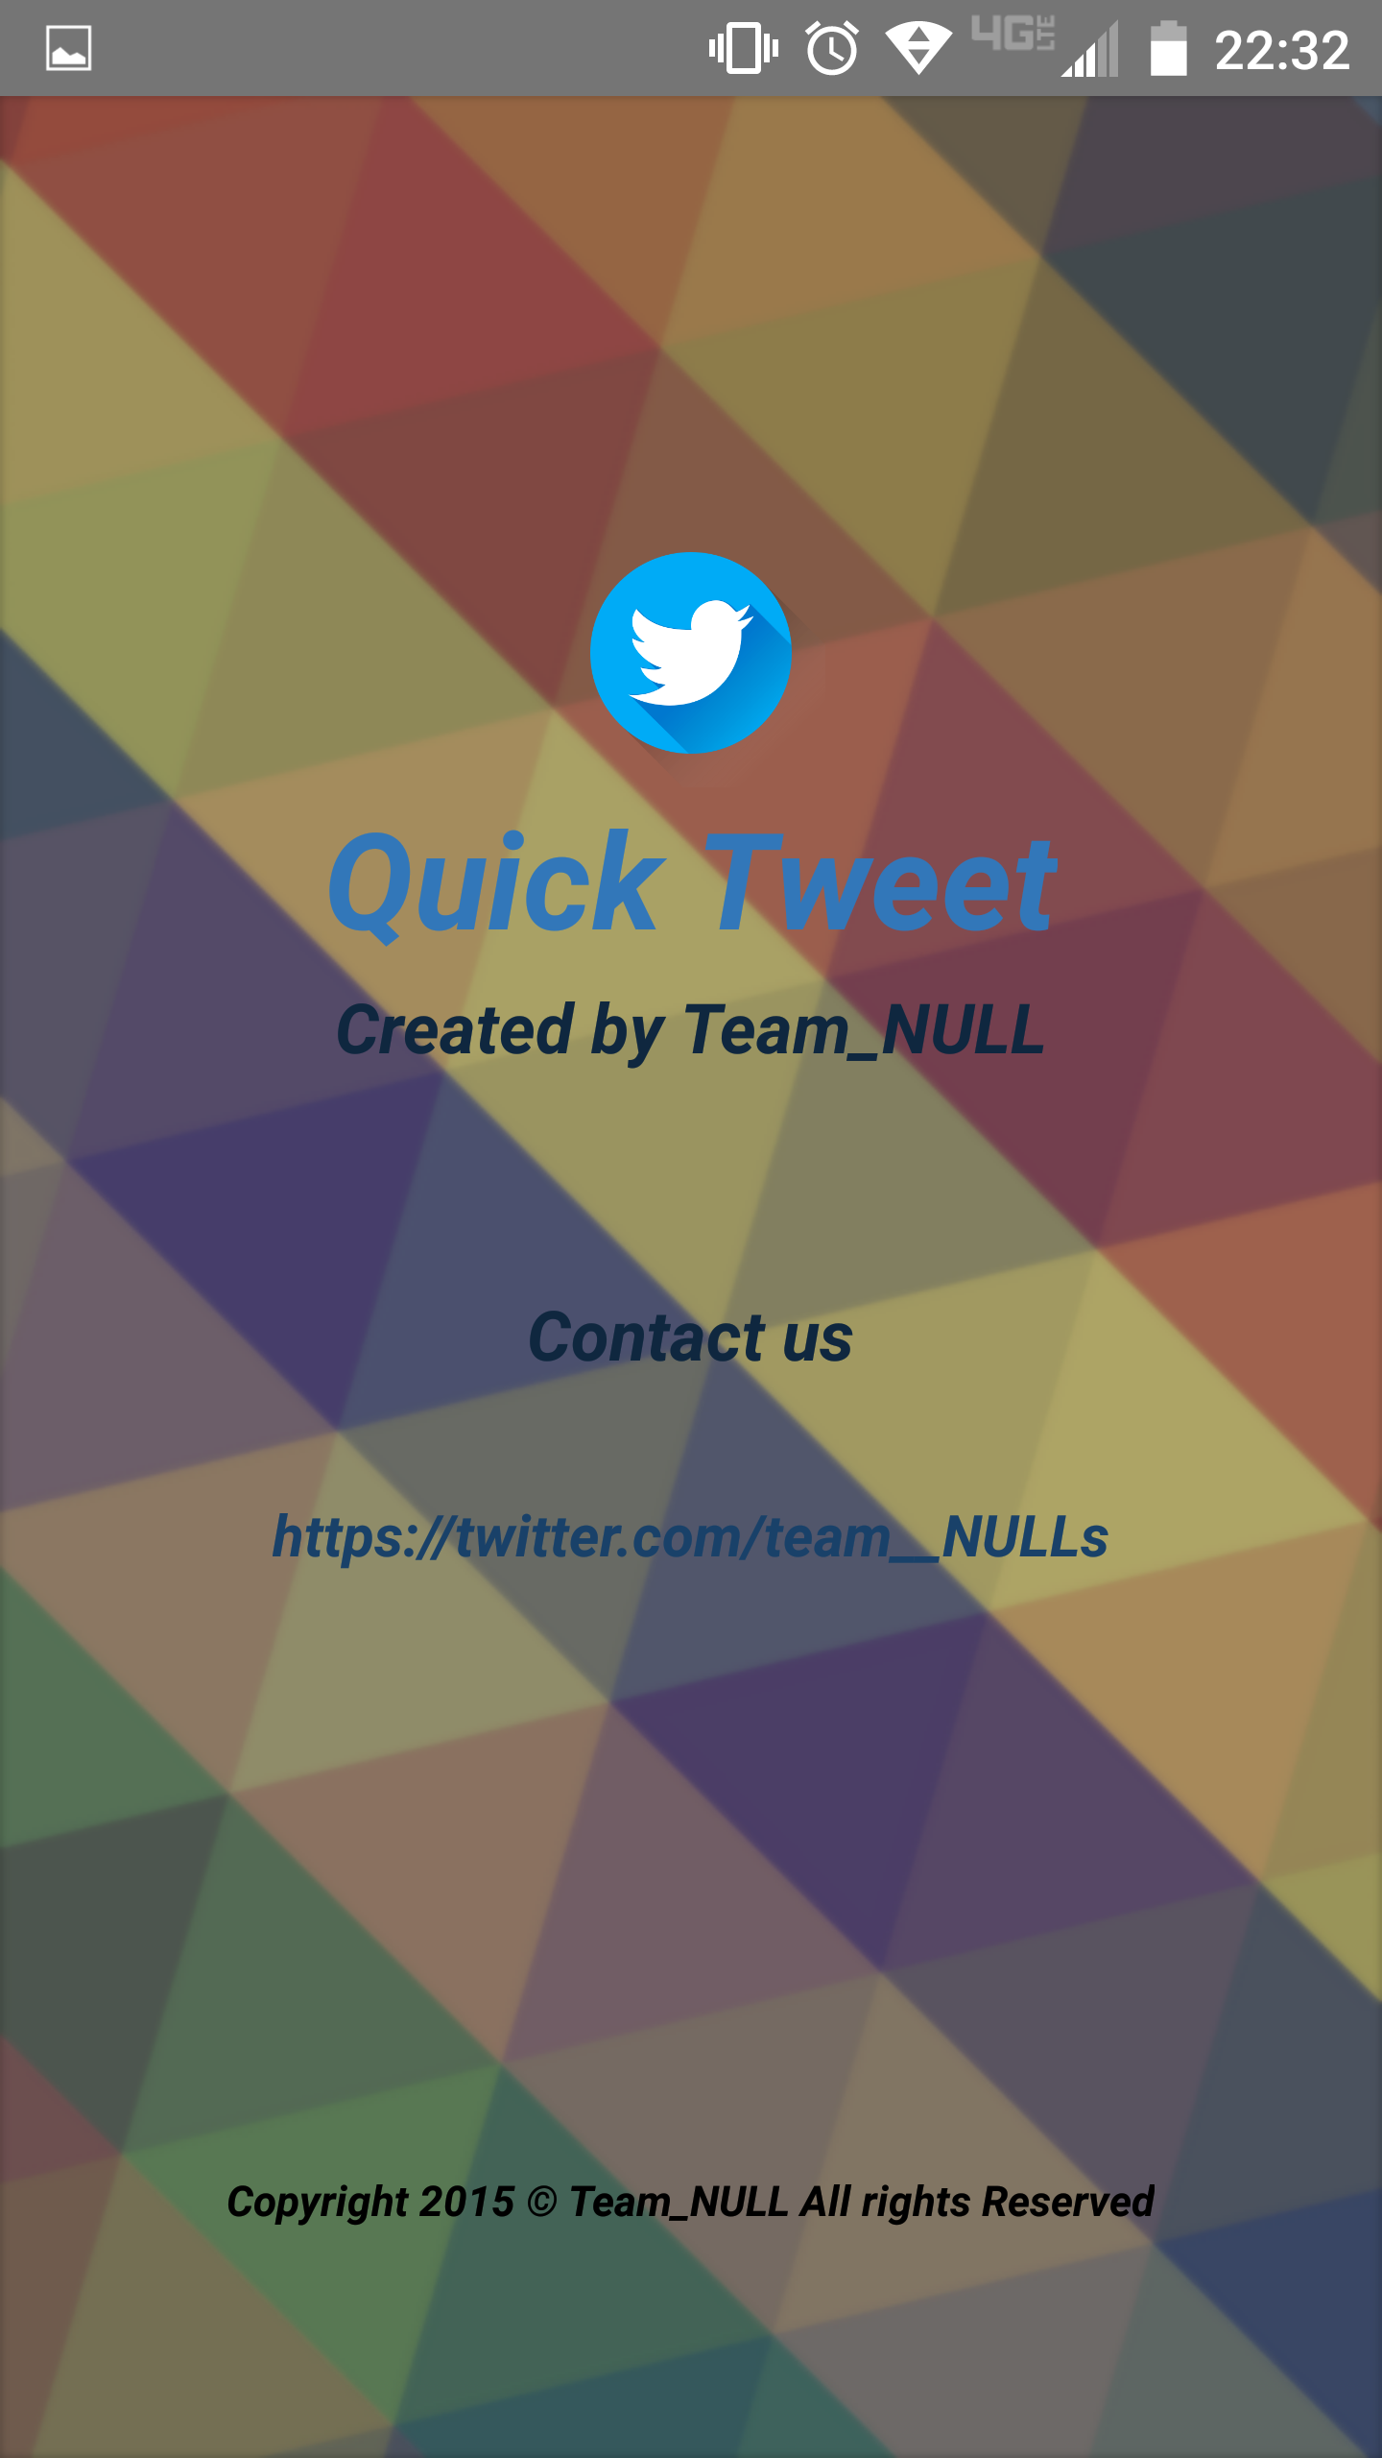
The App Information Screen
This is the screen where information about App developer and contact is showed. This screen would show up once the “About this App” option in the drawer menu is taped on.

Slide 9
App Logic
App opened
User is logged in
Yes
Send-Tweet Screen
Drawer option
Log out
Open Drawer
No
App Information
Send a Tweet
No
Login Screen
Tweet Successful
App Information Screen
Yes
Sign in/Authorize
No
Login Successful
Yes
App closed

Slide 10
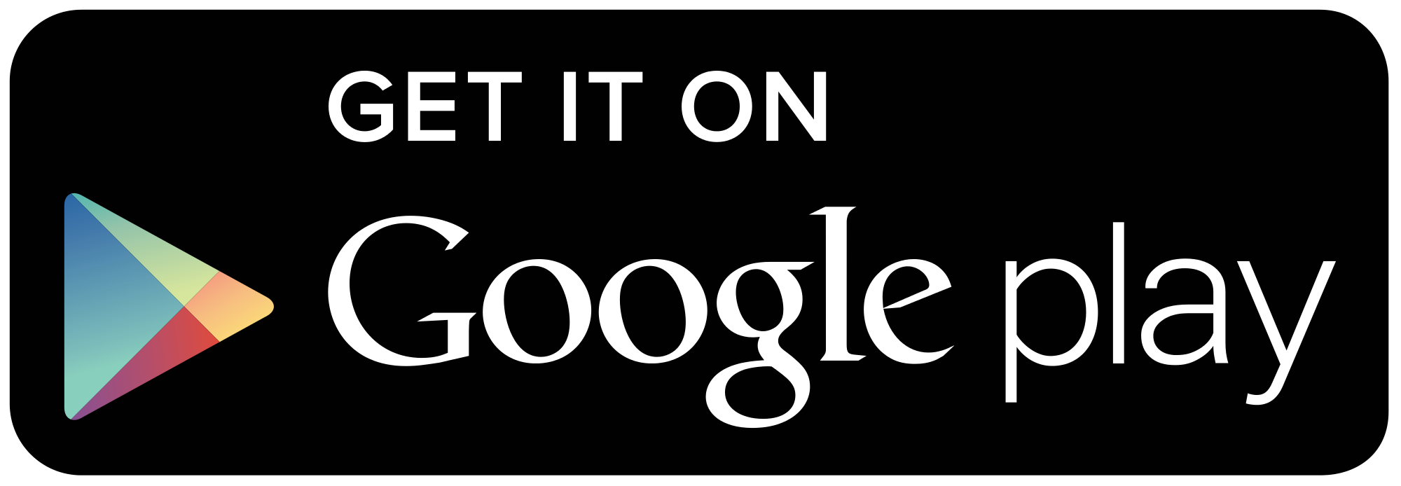
Thank you

